Slide 1

Part III – Civic Literacy Essay

Slide 2
Civil Literacy Essay
Based on accompanying documents
Designed to test your ability to work with historical documents
Analyze each document
Take into account the source of each document
Take into account any point of view that may be presented in the document
Keep in mind the language and images used in a document – they may reflect the historical context of the time in which it was created

Slide 3
Civil Literacy Essay
Describe (illustrate in words, tell about it) the historical circumstances surrounding this constitutional or civic issue
Explain (make plain or understandable, give reasons or causes of, show the logical development or relationship of) efforts to address this constitutional or civic issue by individuals, groups, and/or governments
Discuss (make observations about using facts, reasoning, and argument, present in some detail) the extent to which these efforts were successful OR discuss the impact of these efforts on the United States and/or American society (it will be one or the other)

Slide 4
Civil Literacy Hints
Develop ALL aspects of the task
make sure you answer all parts of the question/task for EACH of your choices
Incorporate information from AT LEAST FOUR DOCUMENTS
they will give you 6 or more documents or sets of documents
Use MLA-style citations when referencing information from the documents (Document 1)

Slide 5
Civil Literacy Hints
Incorporate relevant OUTSIDE INFORMATION
You must have information that is not in the documents (other historical examples, outcomes, details)
Remember the “who, what, when, where, why, and how” model
Who? Where? When? – are there specific details (people, places, things) that are left out?
What? – can you think of additional facts or events that would also go with this theme/topic?
Why? – analysis of the causes and effects

Slide 6
Civil Literacy Hints
Support the Theme/Historical Context with relevant facts, examples, and details
Do not GUESS - if you know specifics, use them…if not, be vague and explain as best you can
Use a logical and clear plan of organization
Include an introduction and a conclusion that are BEYOND A RESTATEMENT OF THE HISTORICAL CONTEXT

Slide 7
Civic Literacy Block
Thesis
Historical Circumstances – what led to the civic issue (events, ideas, people)
Efforts – individual, group, government #1 | Efforts – individual, group, government #2
Success of efforts or impact of efforts (direct or indirect)

Slide 8
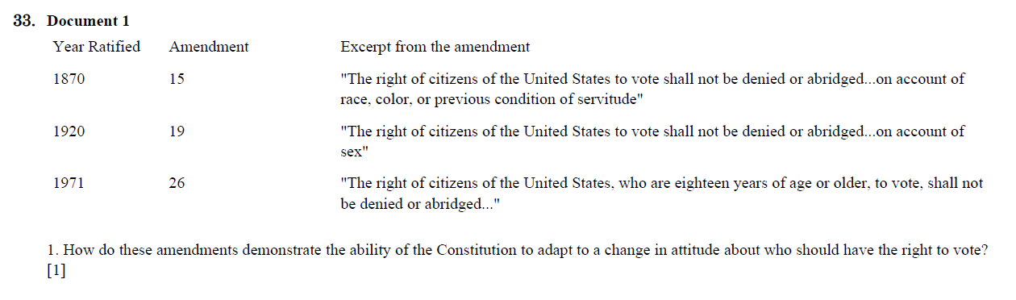

Slide 9
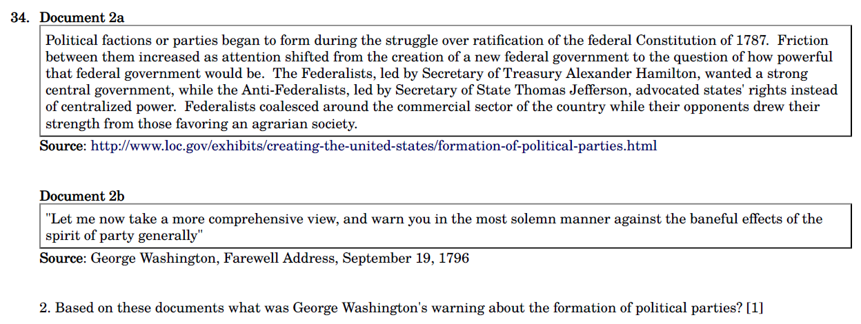

Slide 10
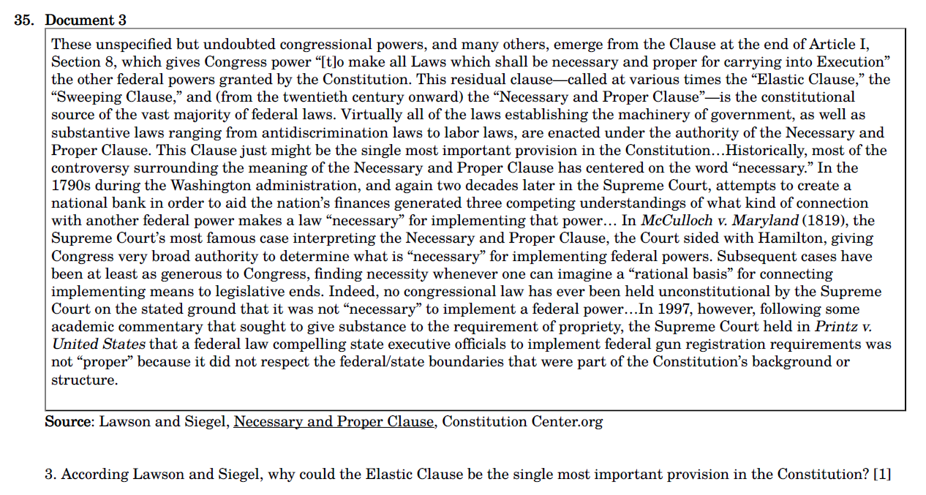

Slide 11
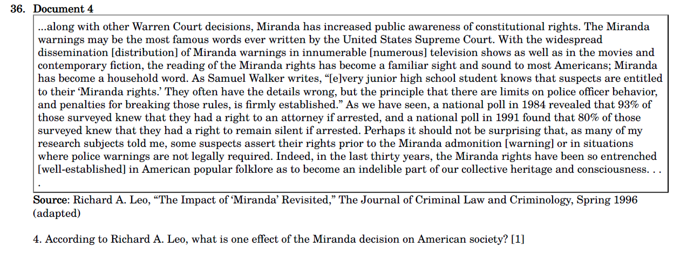

Slide 12
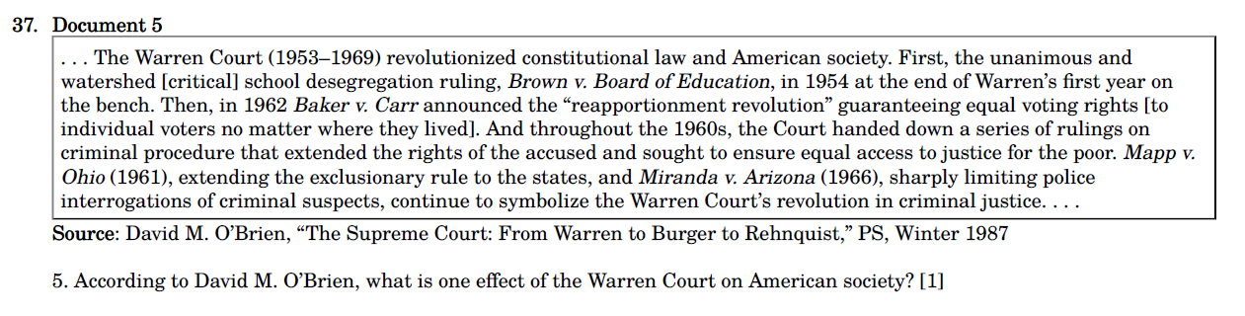

Slide 13
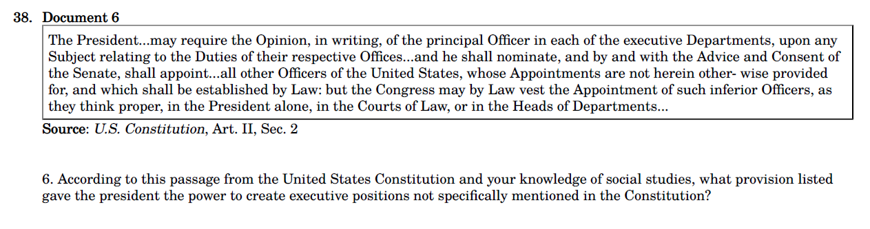

Slide 14
